Slide 1
TOWNTREK
See the city through my eyes

Slide 2
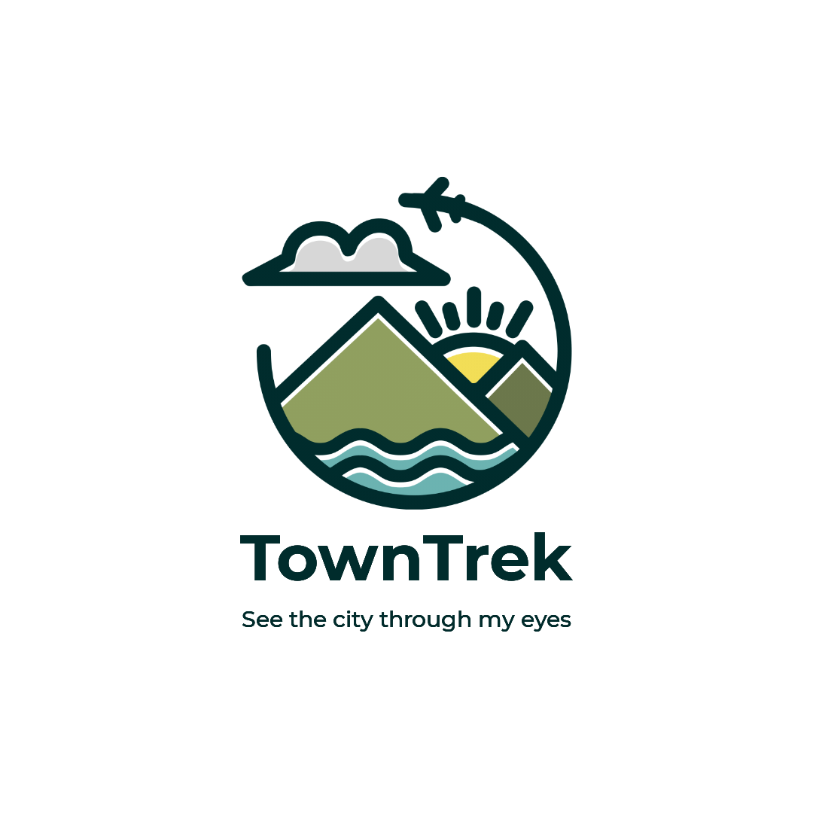
TOWNTREK TEAM
Mohammod Abdullah Bin Hossain
Id:2022351642
Ristian Uddin
Id: 2021188642

Slide 3
TOWNTREK
“See the city through my eyes”

Slide 4
Requirement definition for TownTrek
Android Studios(SDK 33)
Programming language: JAVA
UI language design: XML
Firebase database for user authentication.
Google map platform for API services(Like places API, direction API, etc.)
OpenWeatherMap (For real-time forecasting API)

Slide 5
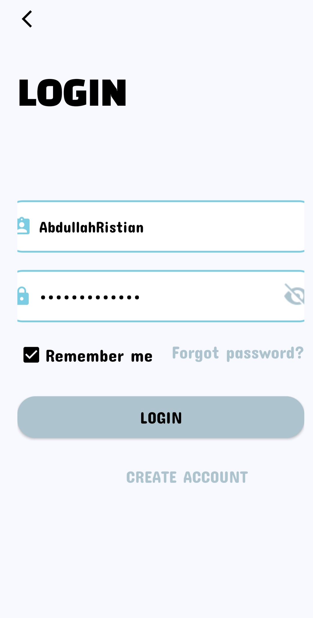
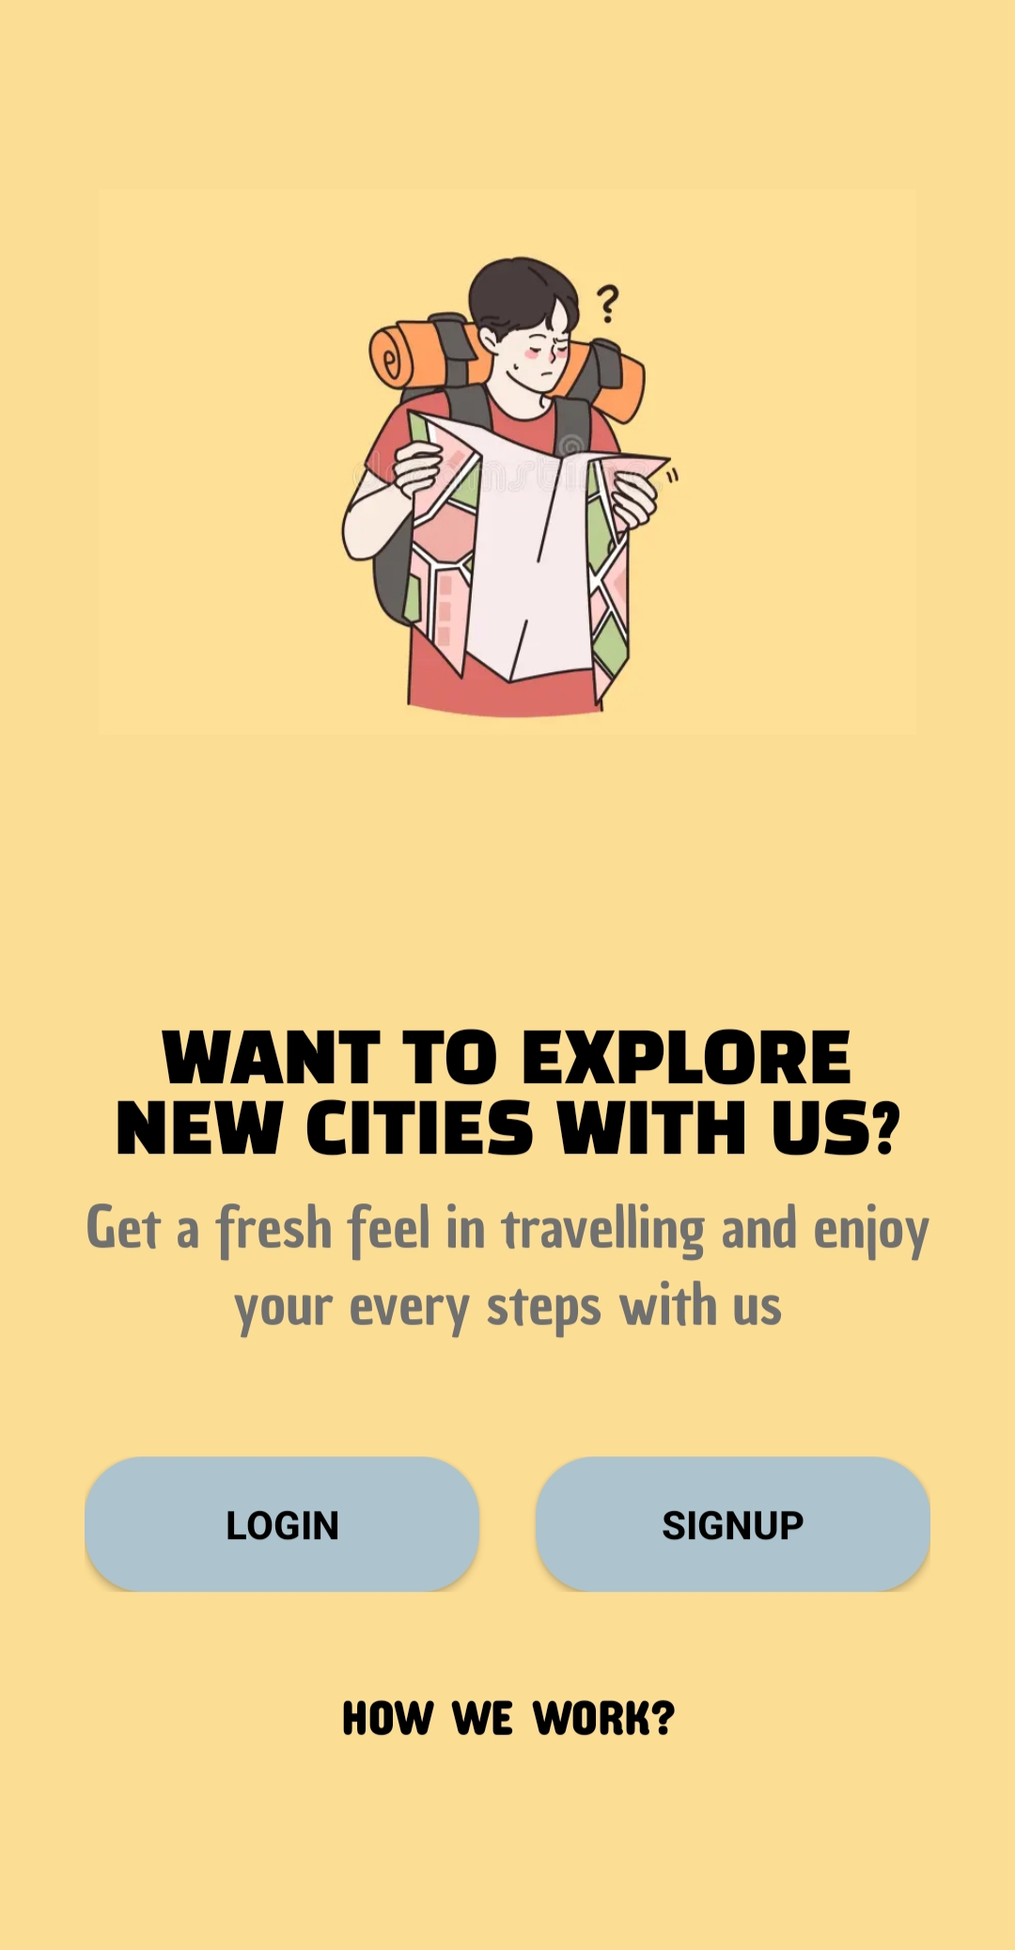
Retailer Screen Overview and Login
SIGNUP
If you are new to TownTrek, please create an account or signup
LOGIN
If you are an existing member of our application, then log in.

Slide 6
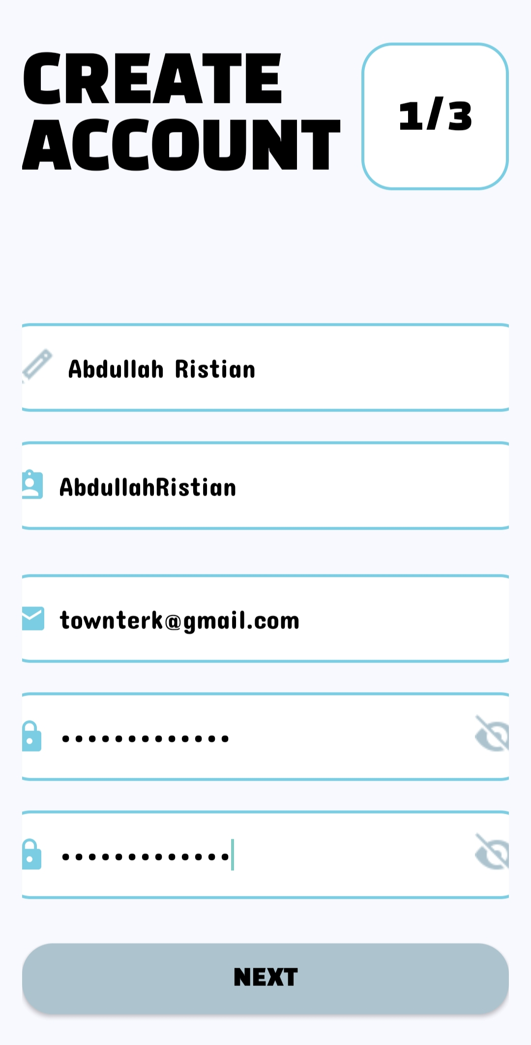
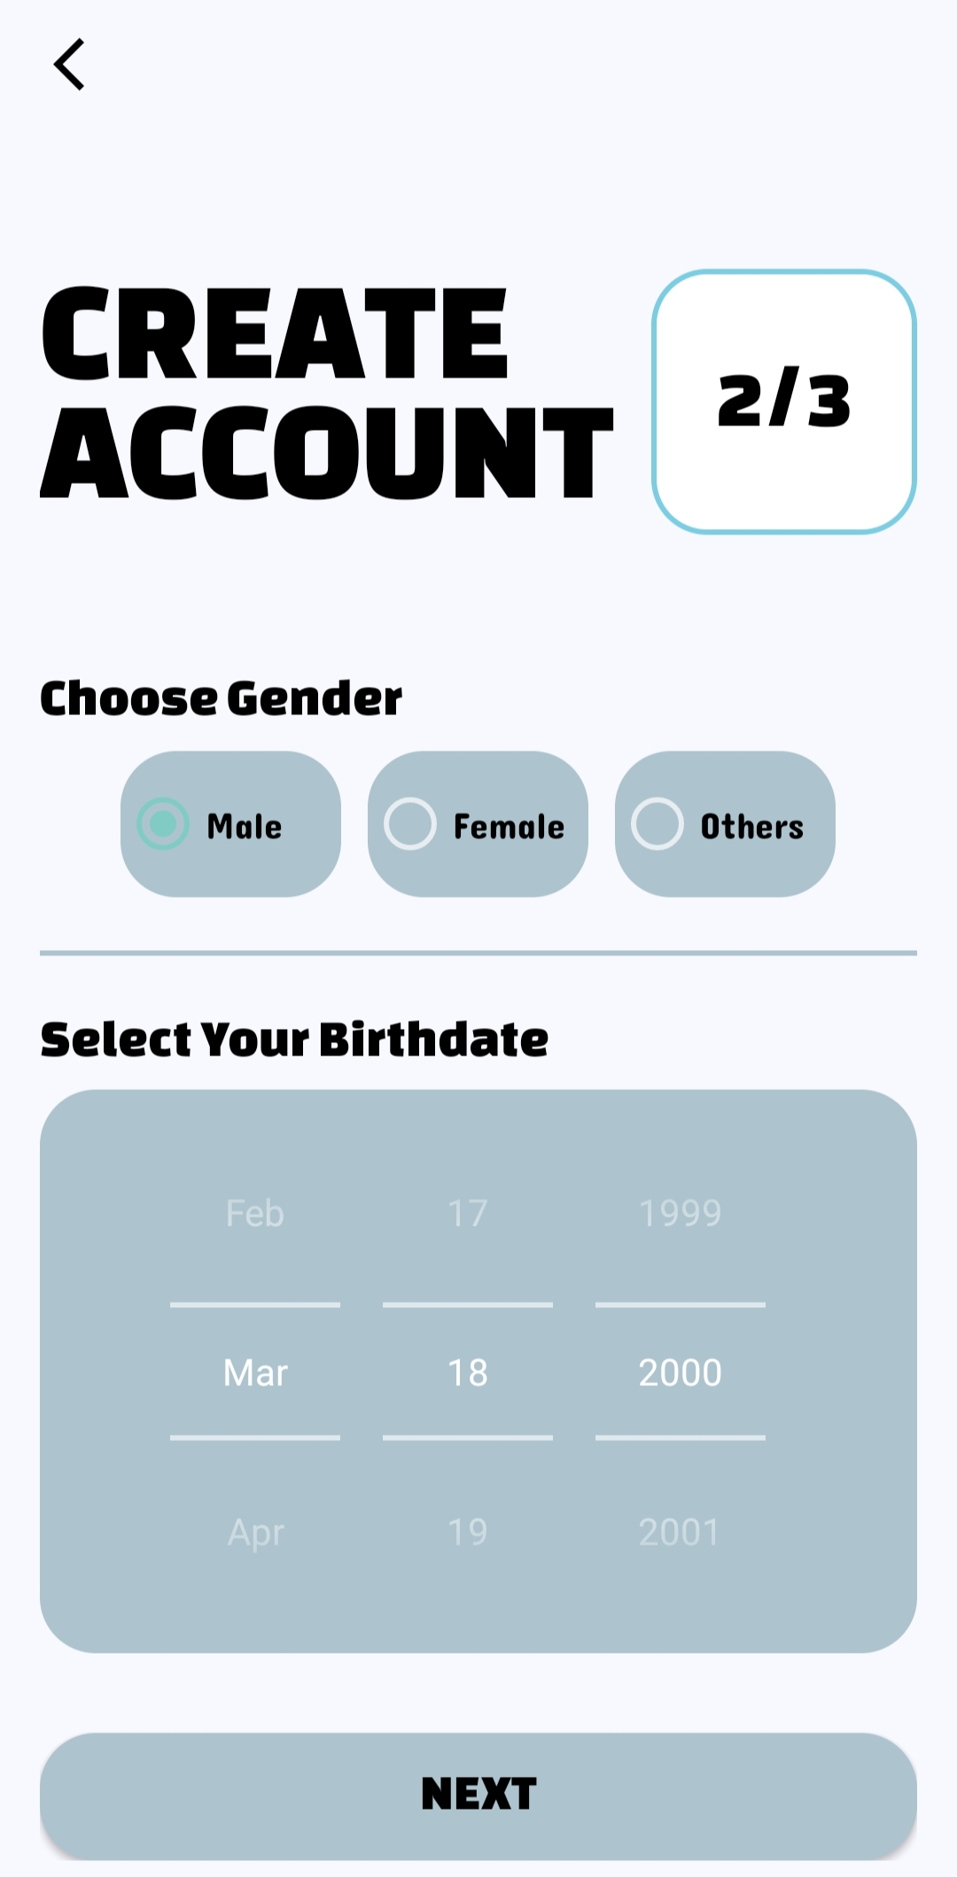
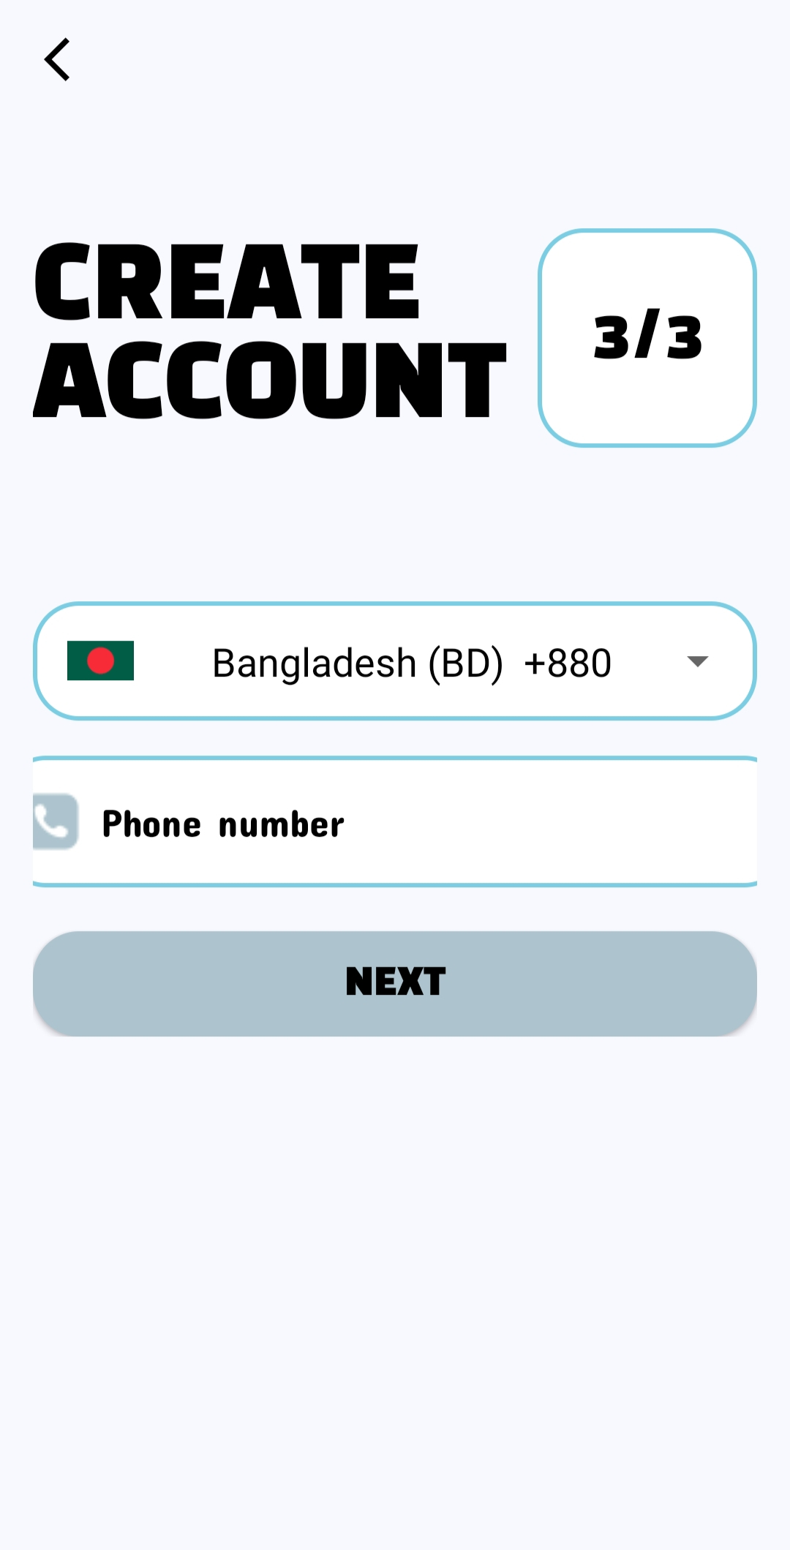
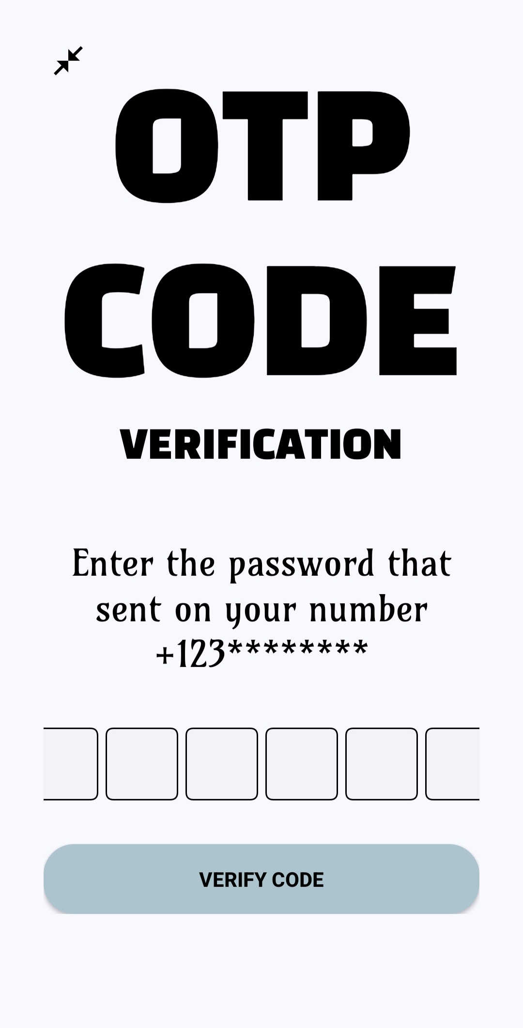
SIGNUP PAGE OVERVIEW
1
2
3
4

Slide 7
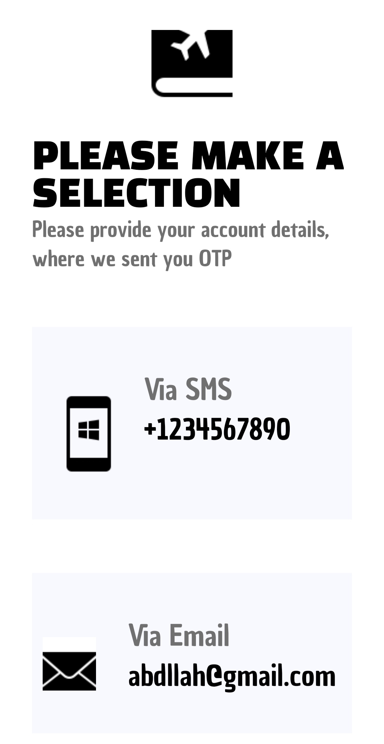
Password recovery
1
2
3

Slide 8
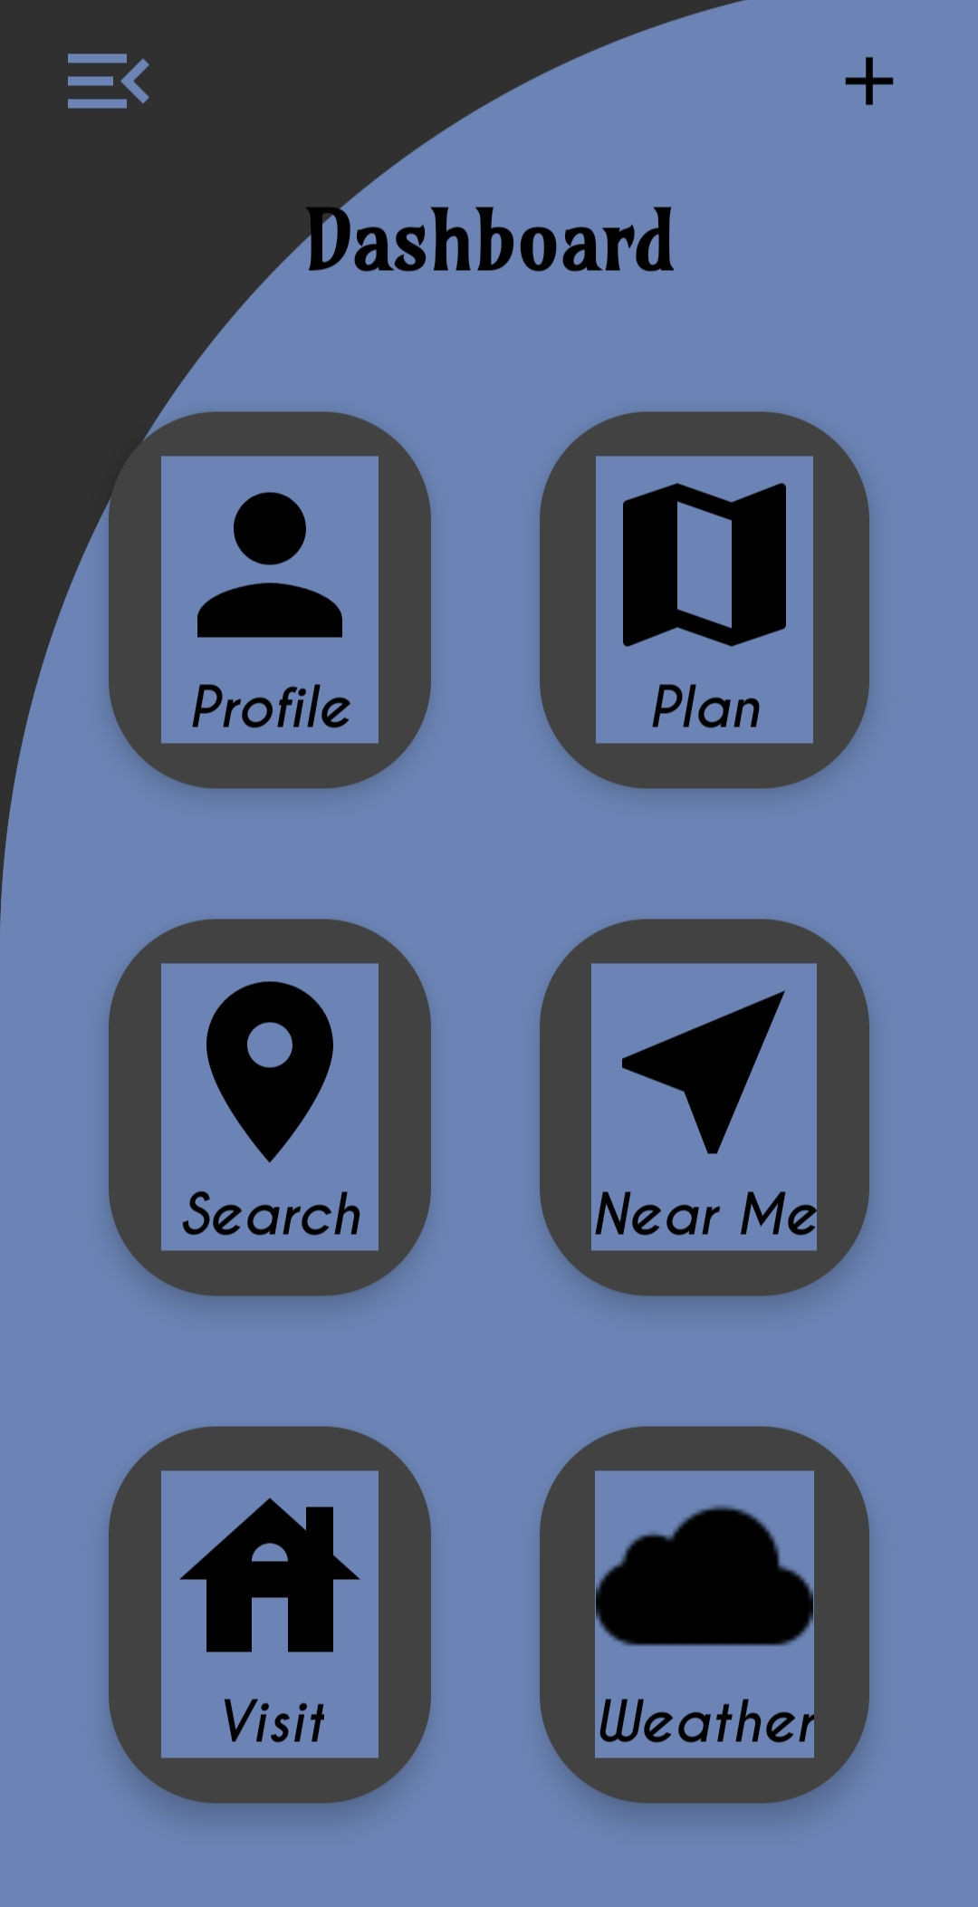
DASHBOARD
Our Dashboard has six features:
Planning
Tracking my location
Necessaries near by me
Tracking nearest tourist places with historical information
Weather update
profile
“Unveiling the Heartbeat of Your City”

Slide 9
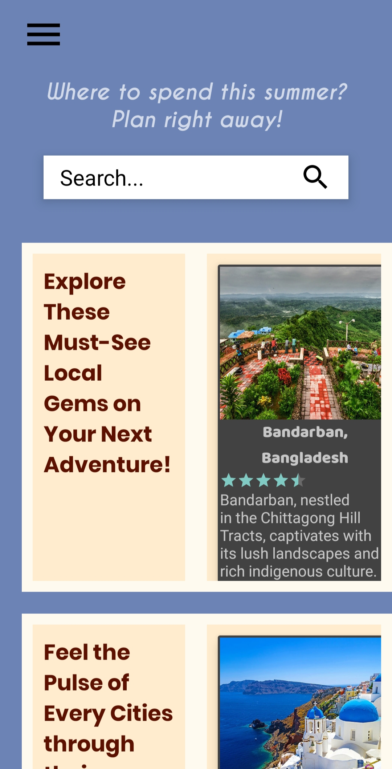
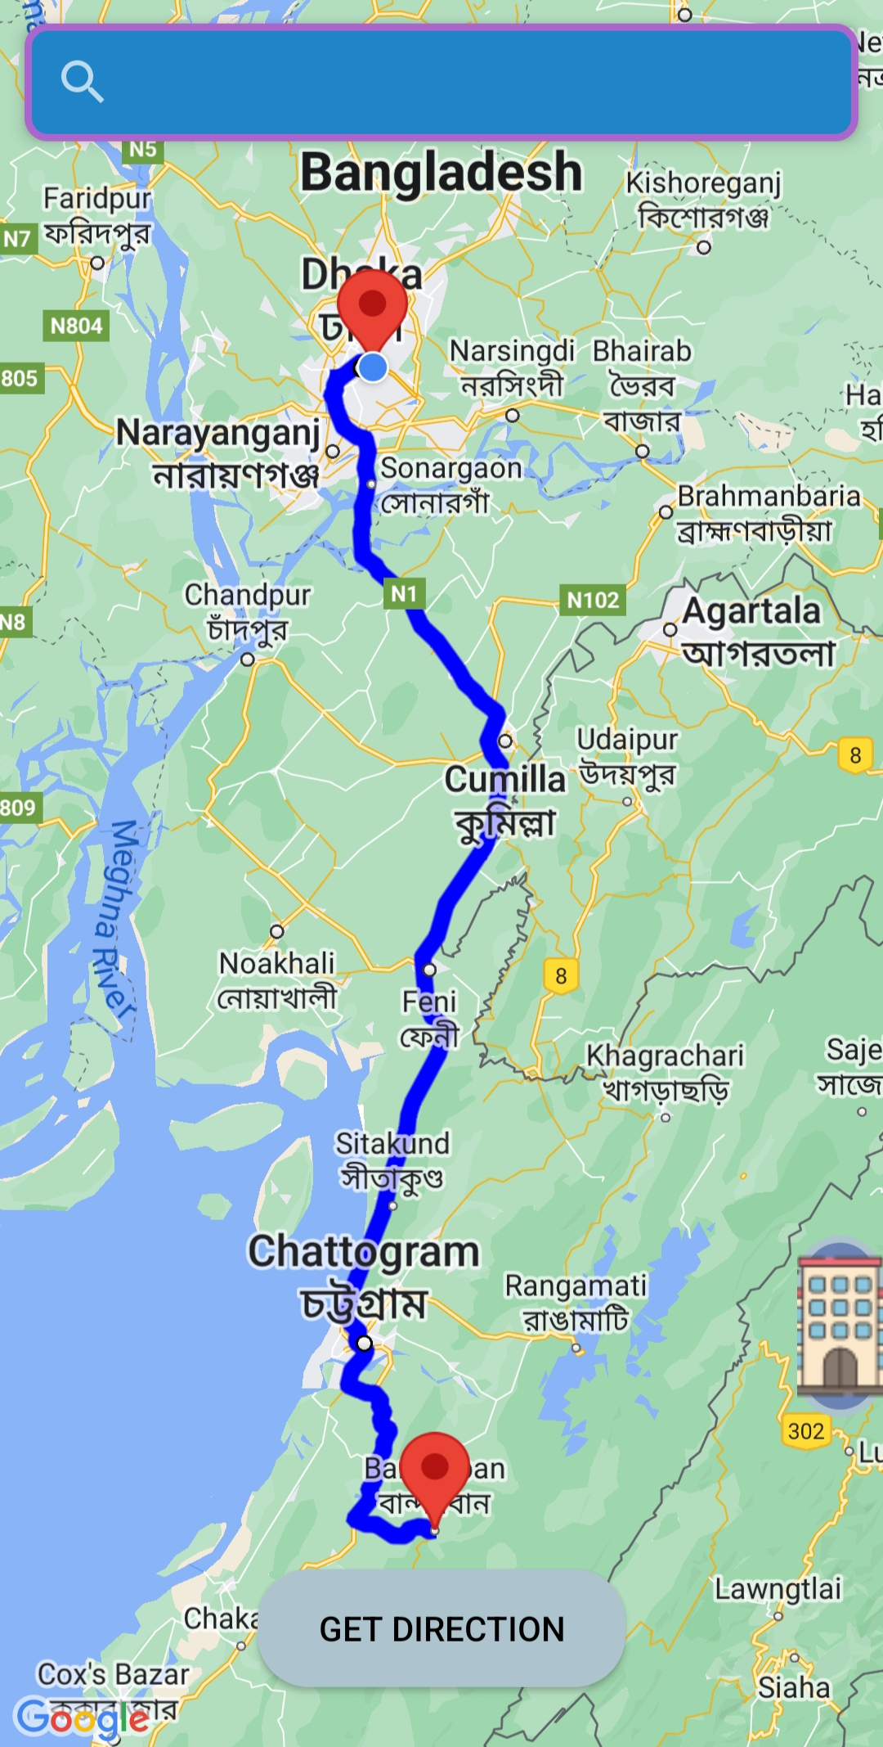
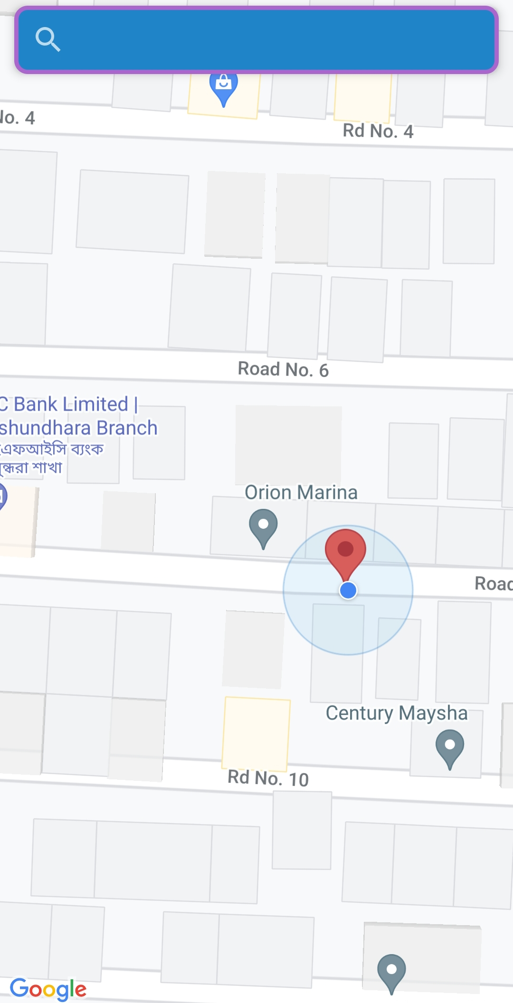
Planning screen and location tracking
Planning screen
Location tracking screen
By utilizing the "plan" button, users can select any destination, whether inside or outside the country. Additionally, “TownTrek” offers a feature allowing users to track the direction from their current location to the planned destination.
The "Search" section of our application enables users to pinpoint their current location, providing a convenient way for them to identify their whereabouts.

Slide 10
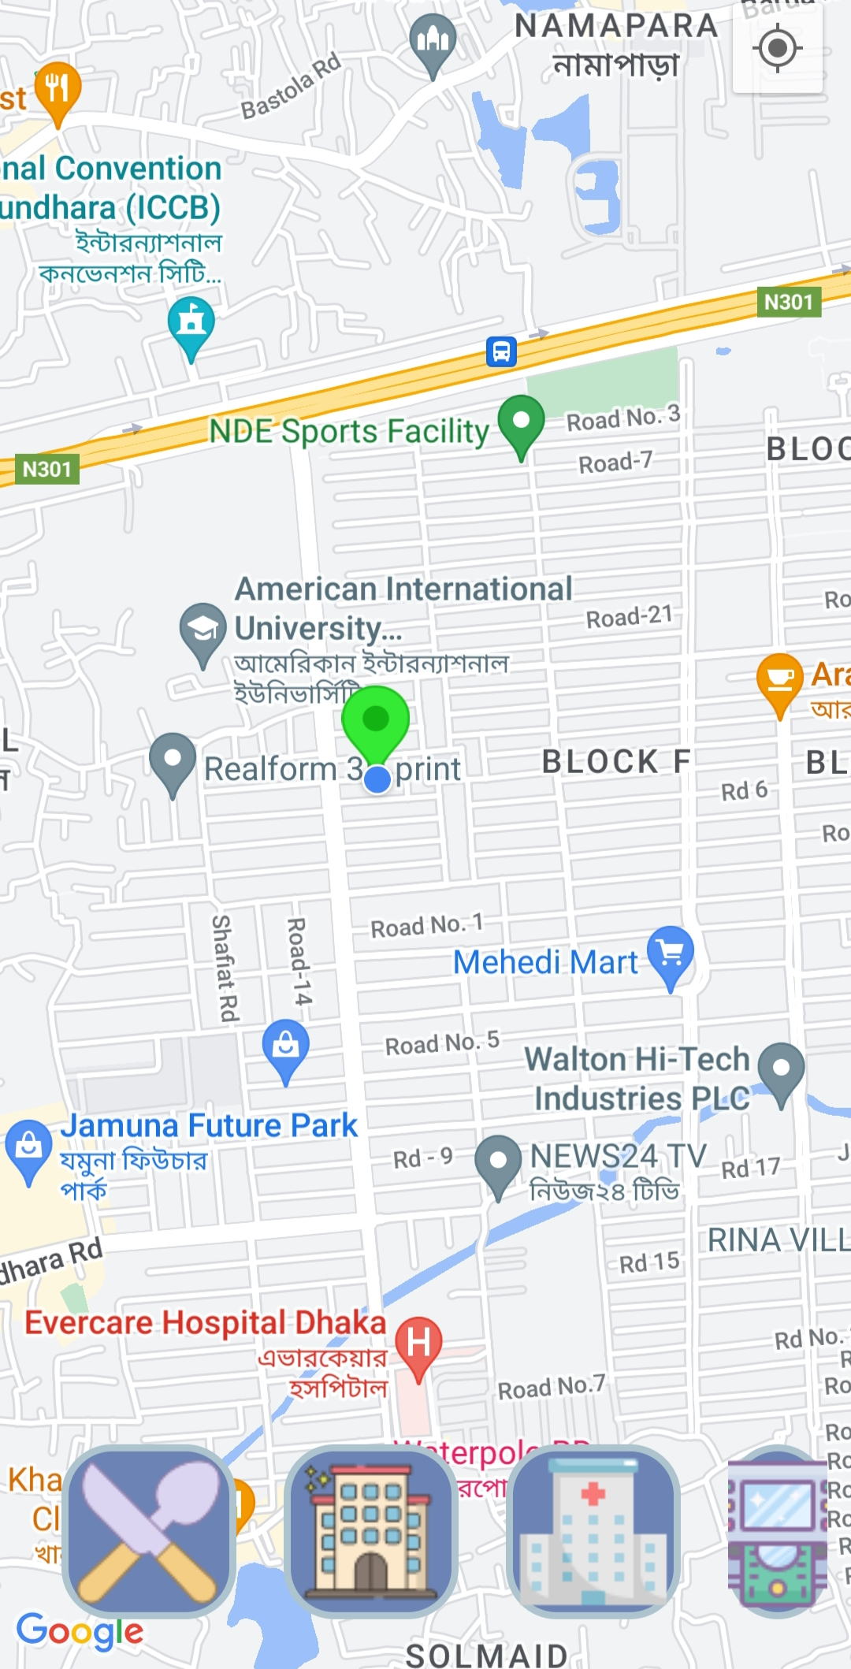
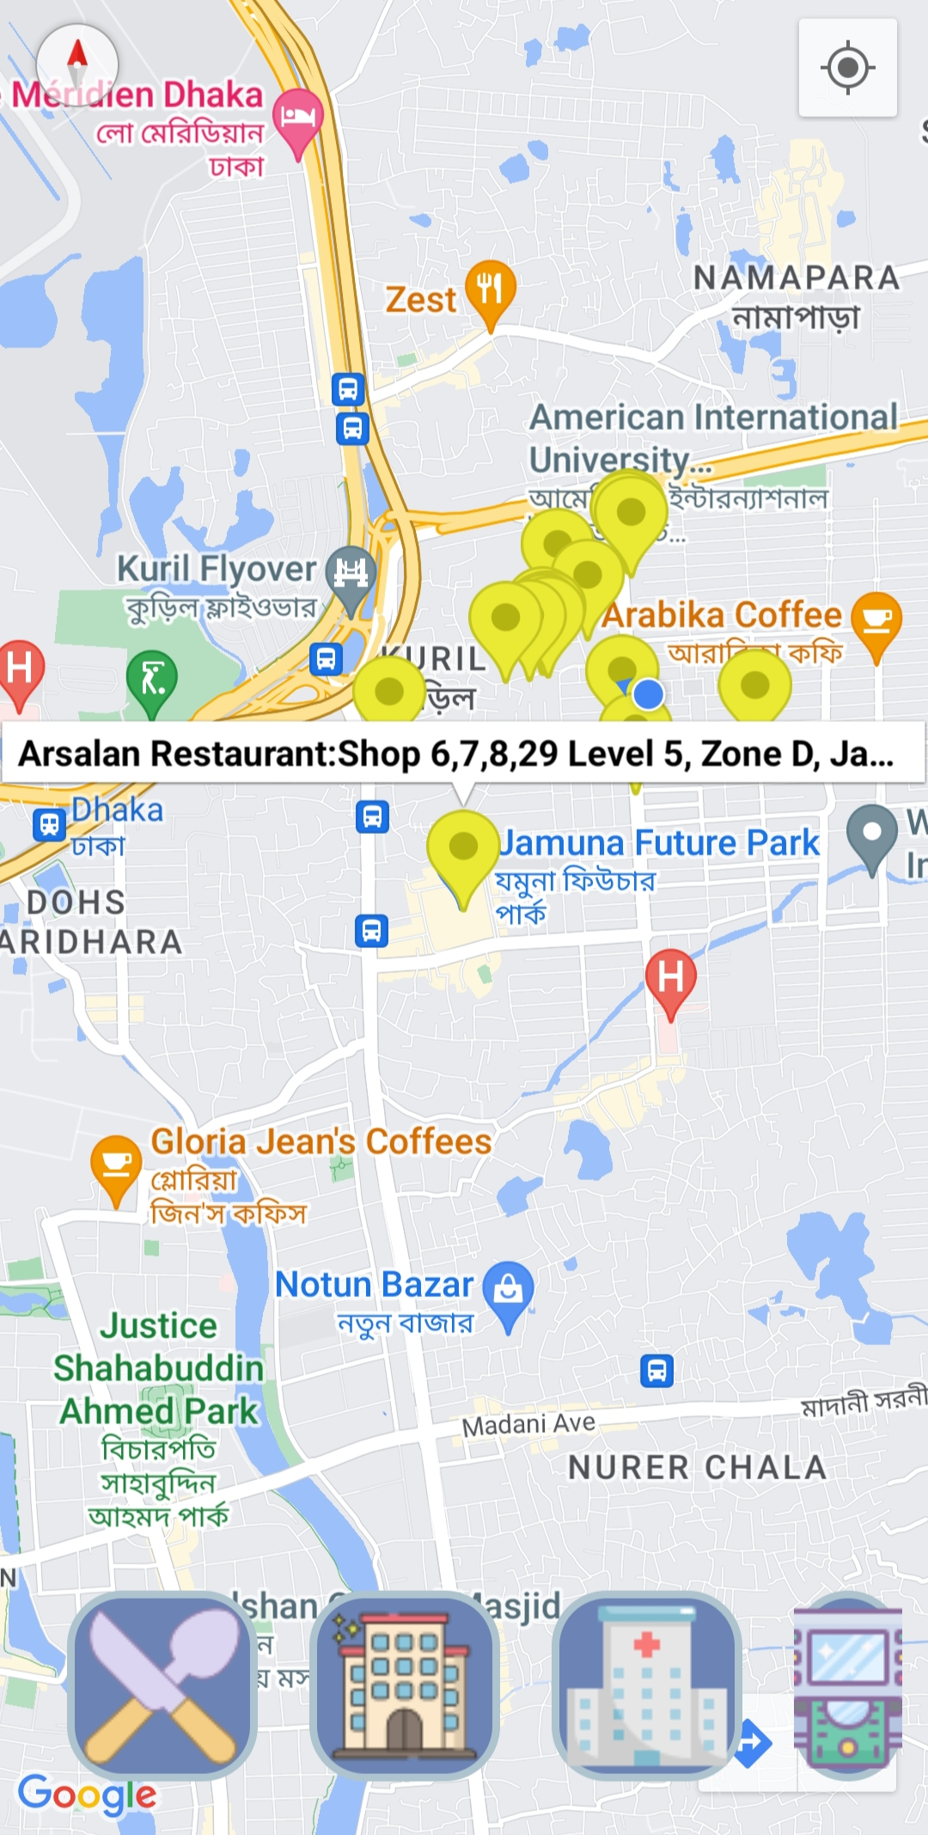
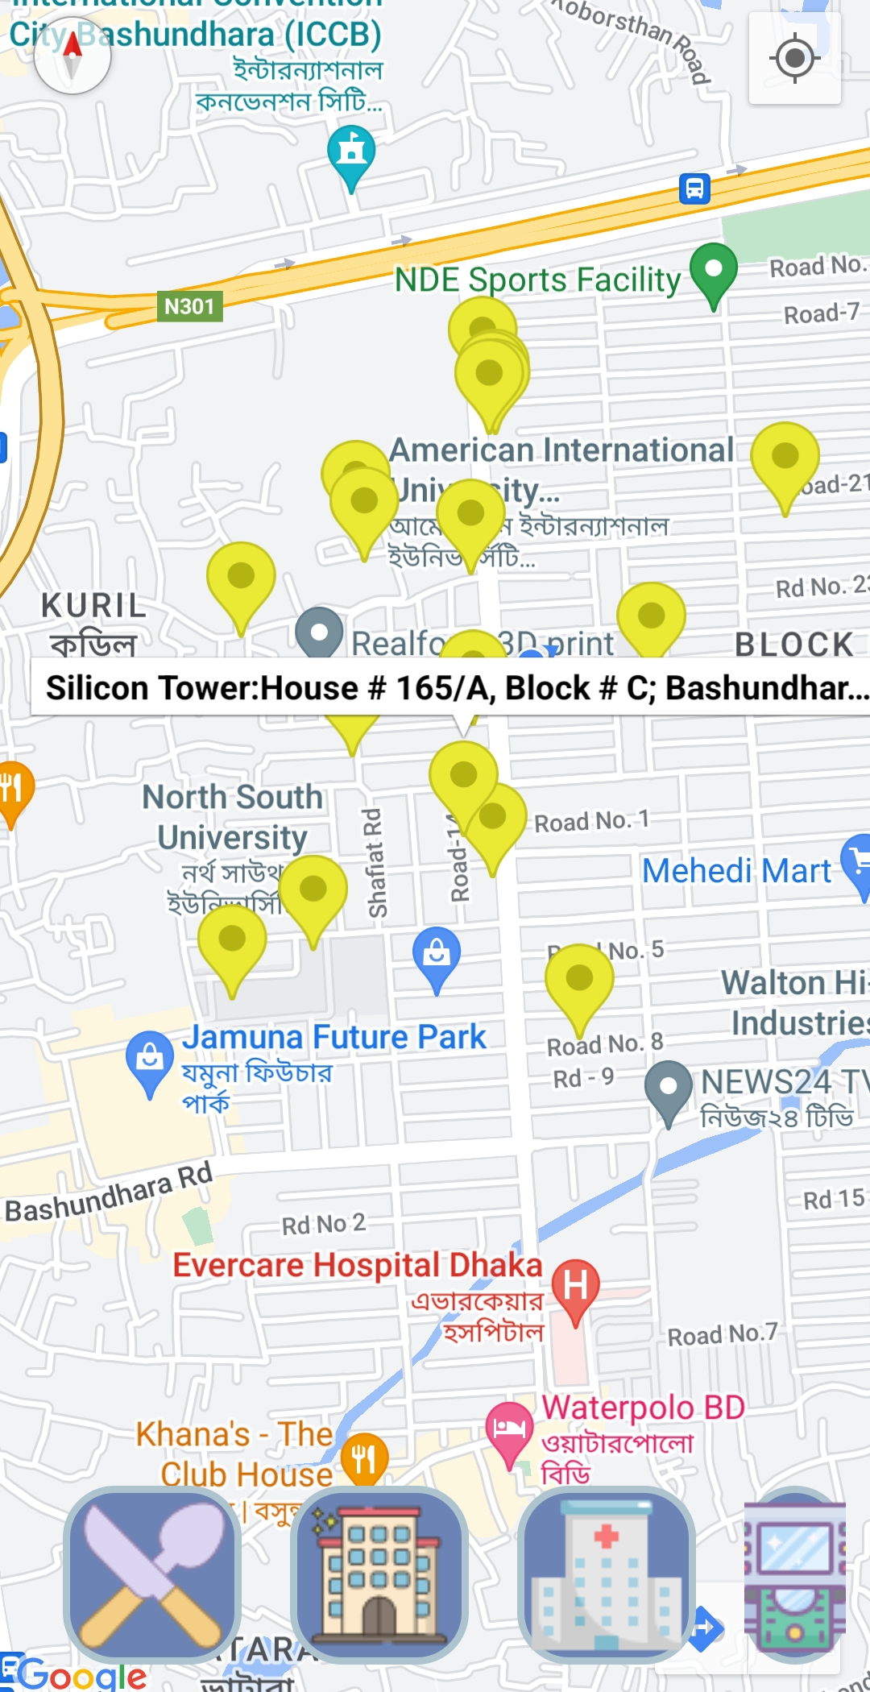
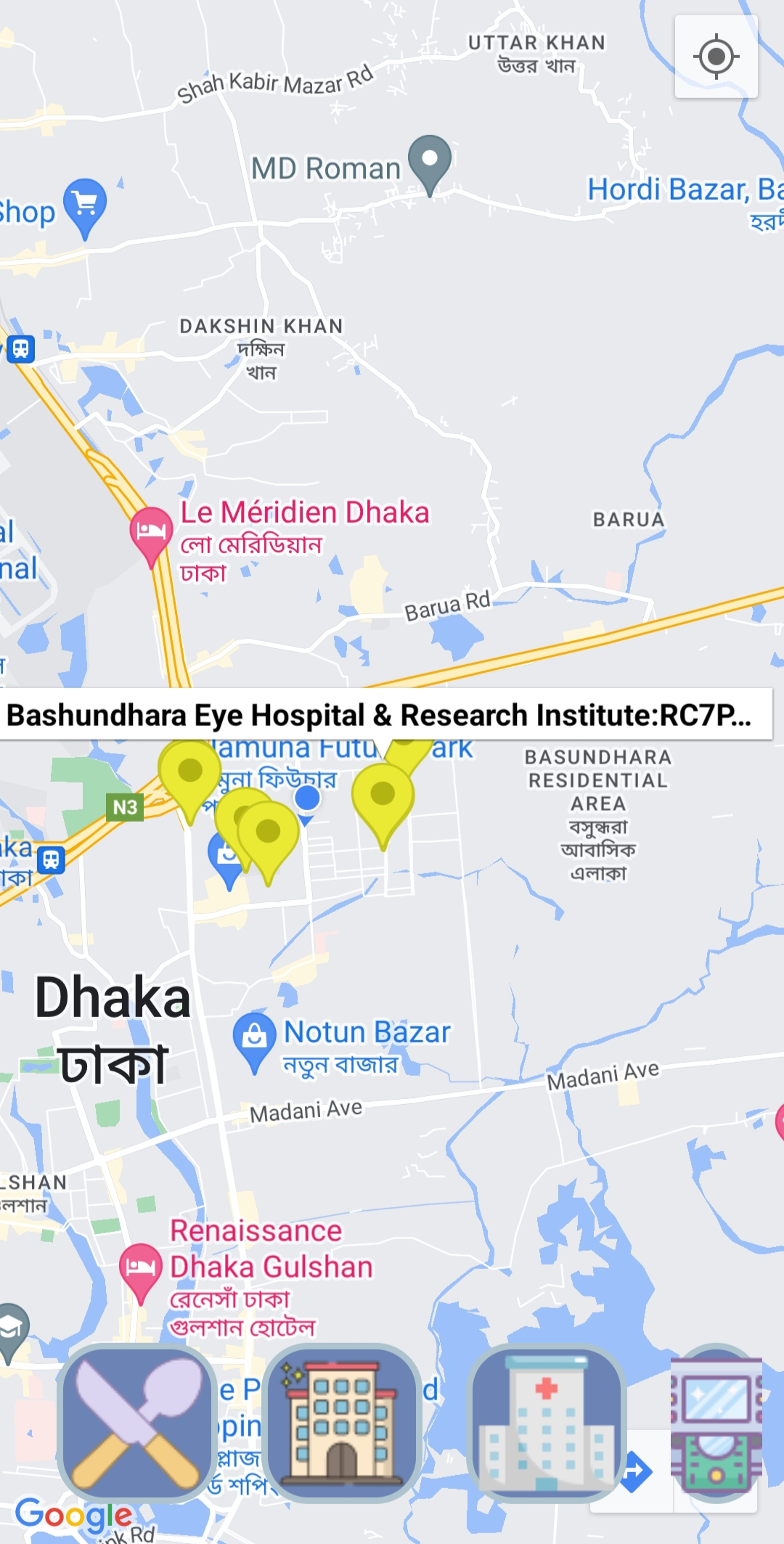
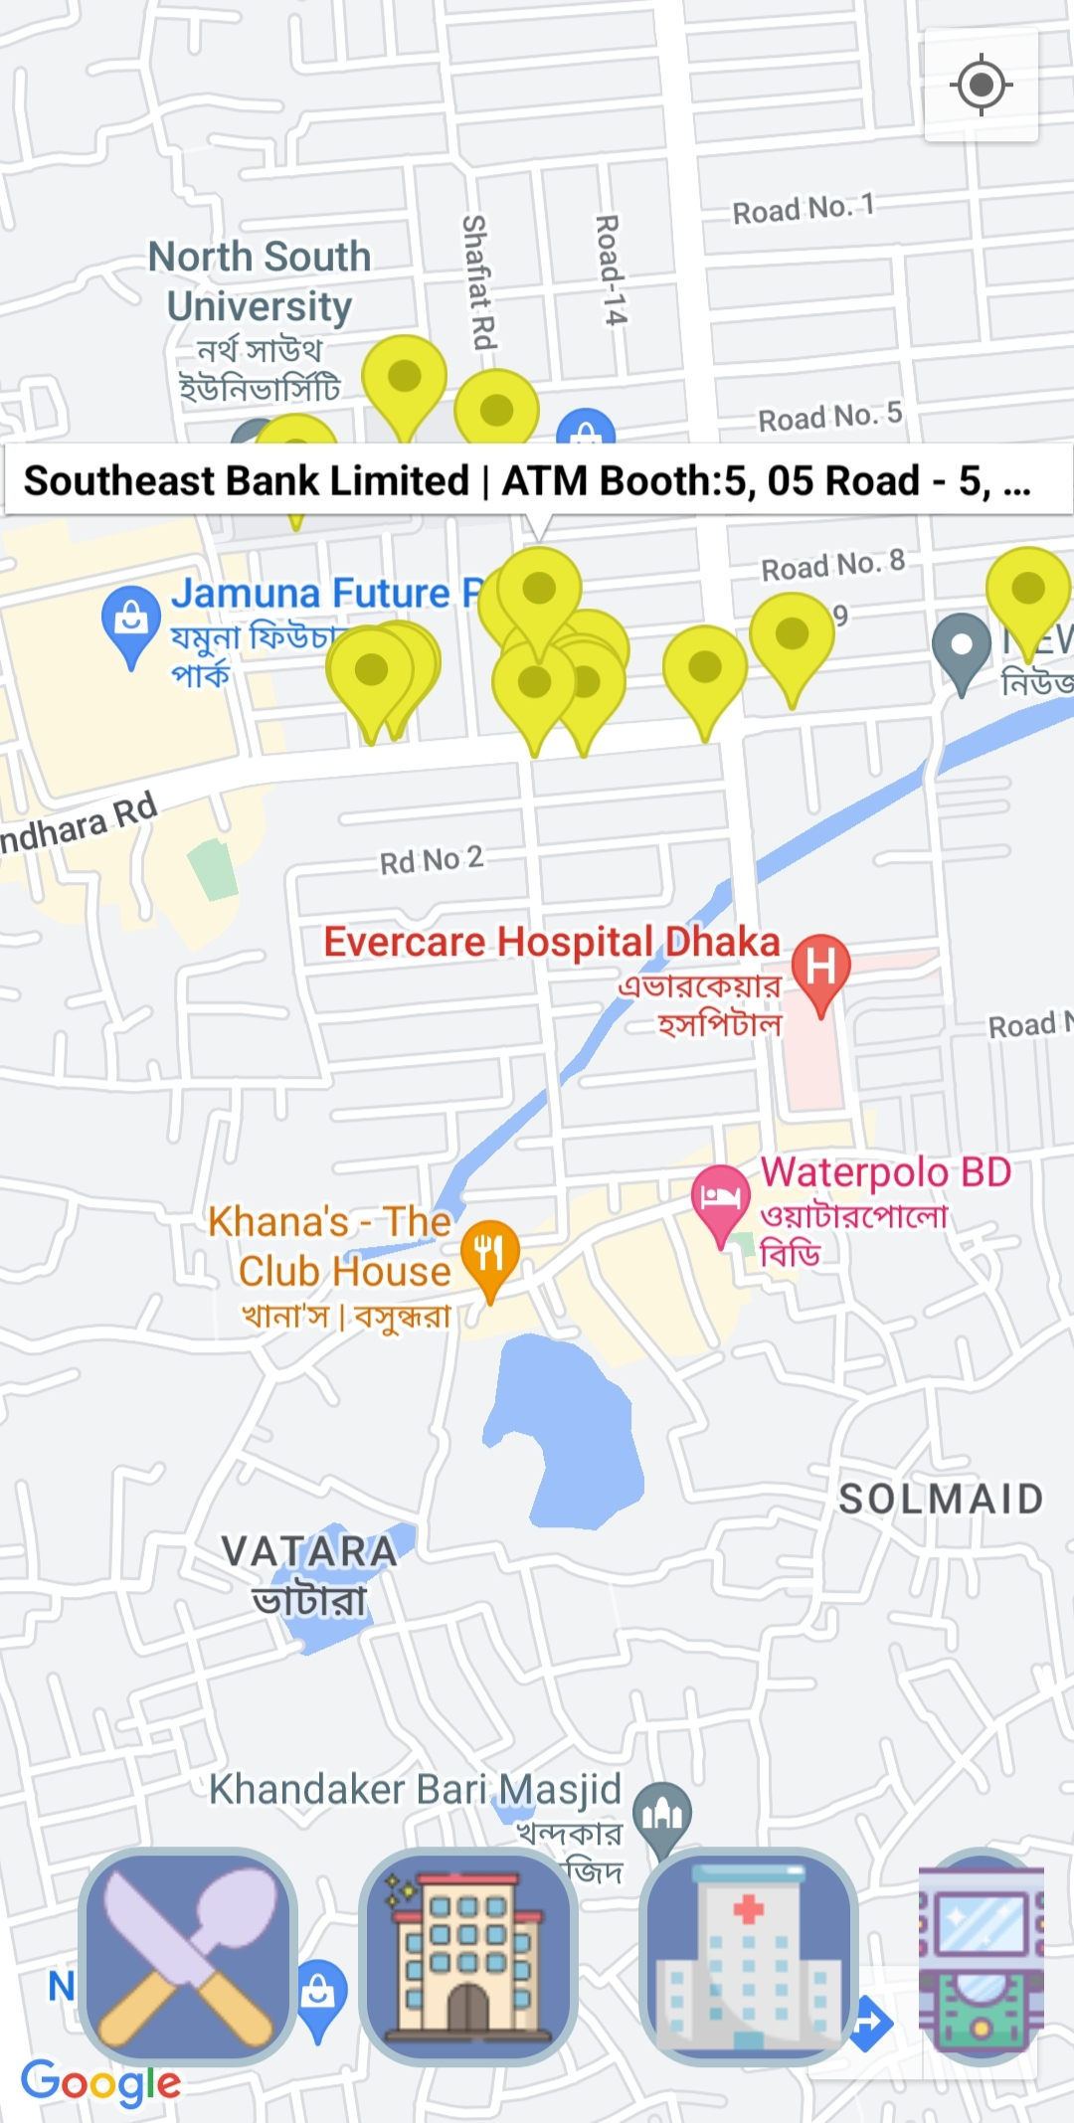
Necessaries near by me
1
2
3
4
5
Current location
Nearby Restaurants
Nearby Hotels
Nearby Hospitals
Nearby ATMs
By utilizing “Near Me” button users can track the nearest restaurants, hotels, hospitals, and ATMs from their current location.

Slide 11
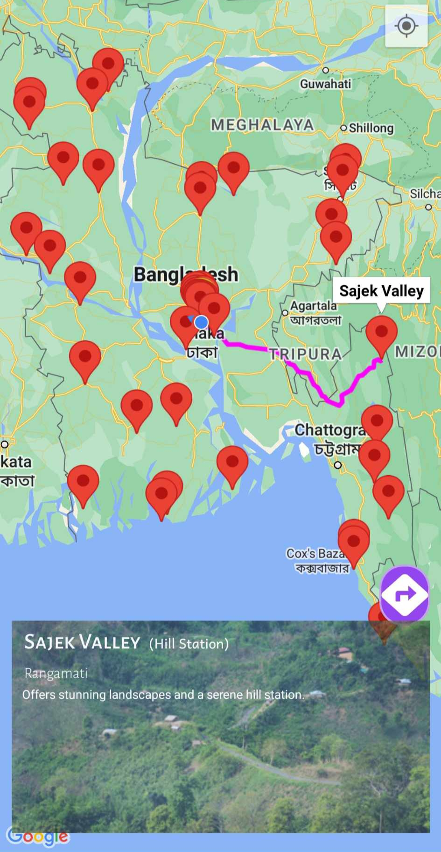
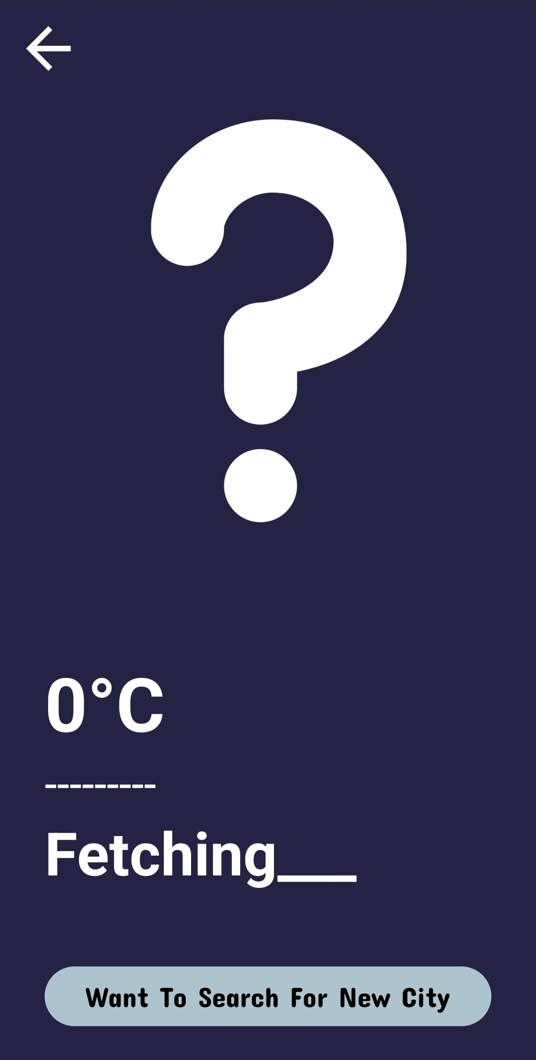
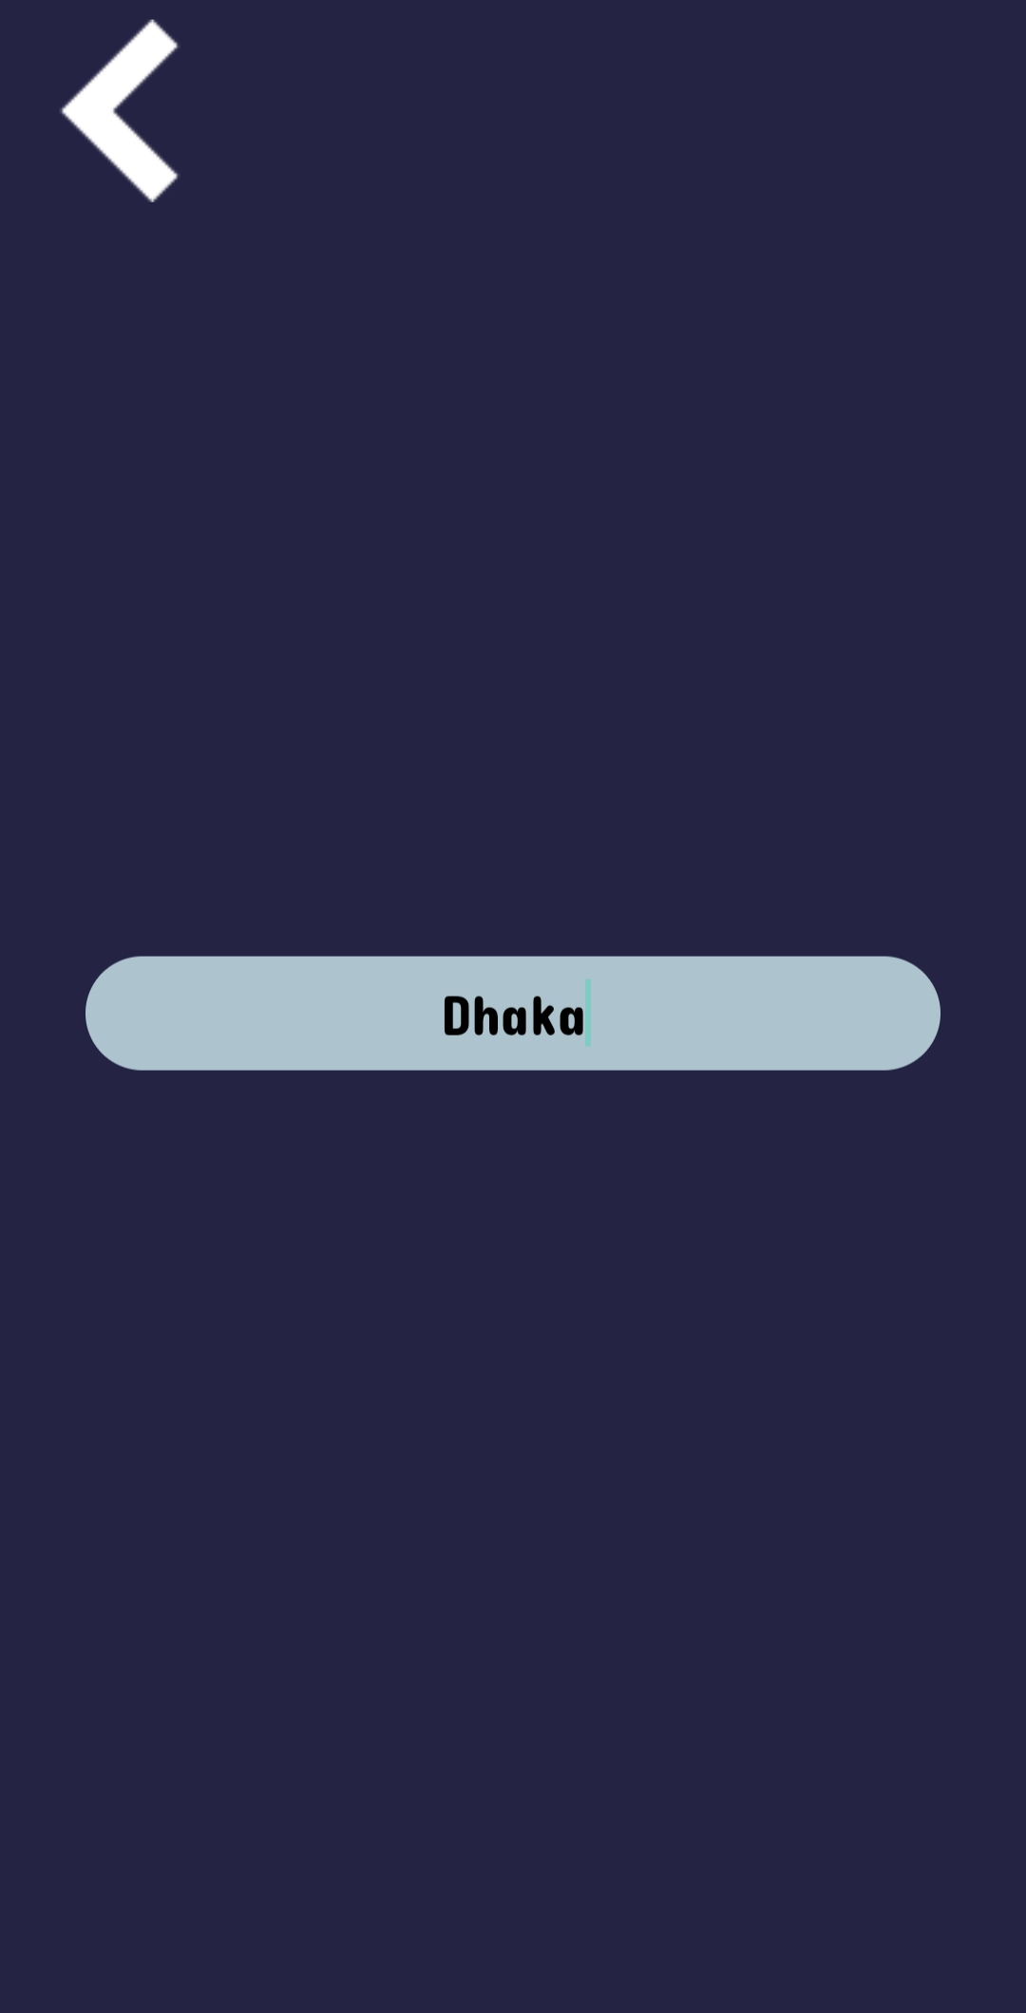
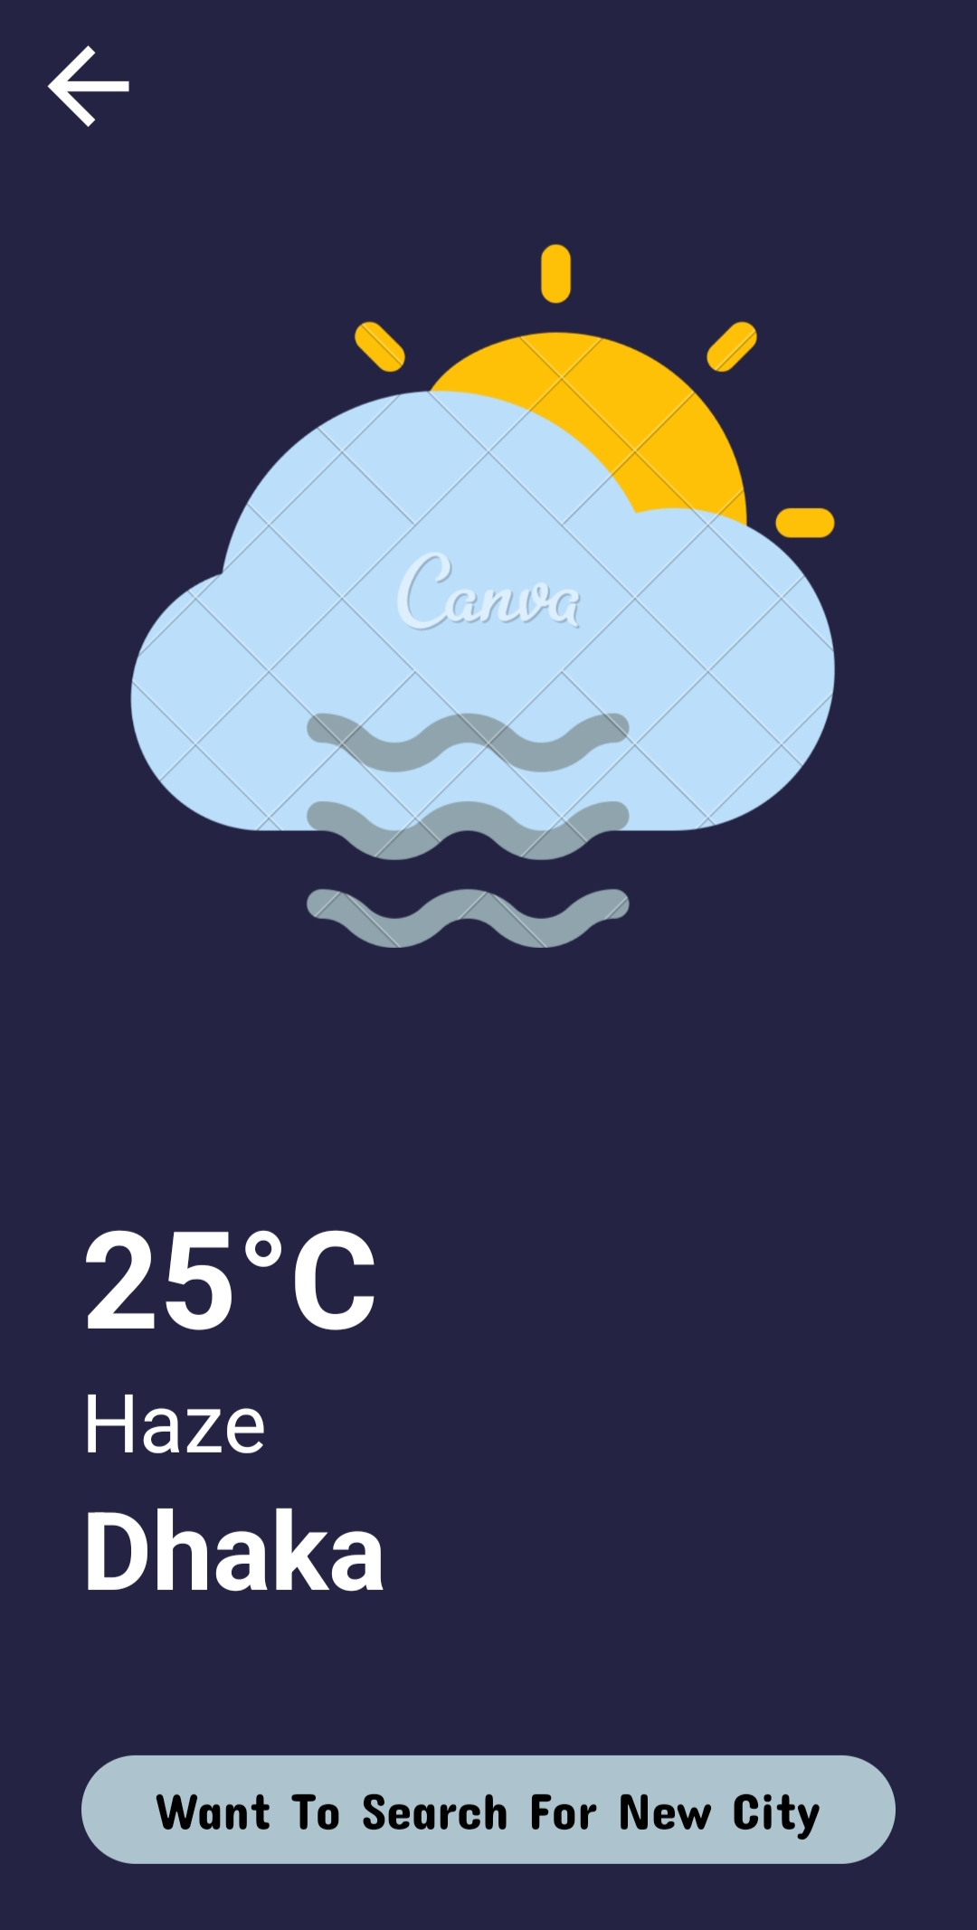
Visiting Historical Spots and Weather Update
Historical spot
Weather Update
Exploring the "Visit" feature, users can uncover nearby historical gems, delving into the rich tapestry of each location's unique historical background.
By Weather update feature, users can track a particular place’s weather

Slide 12
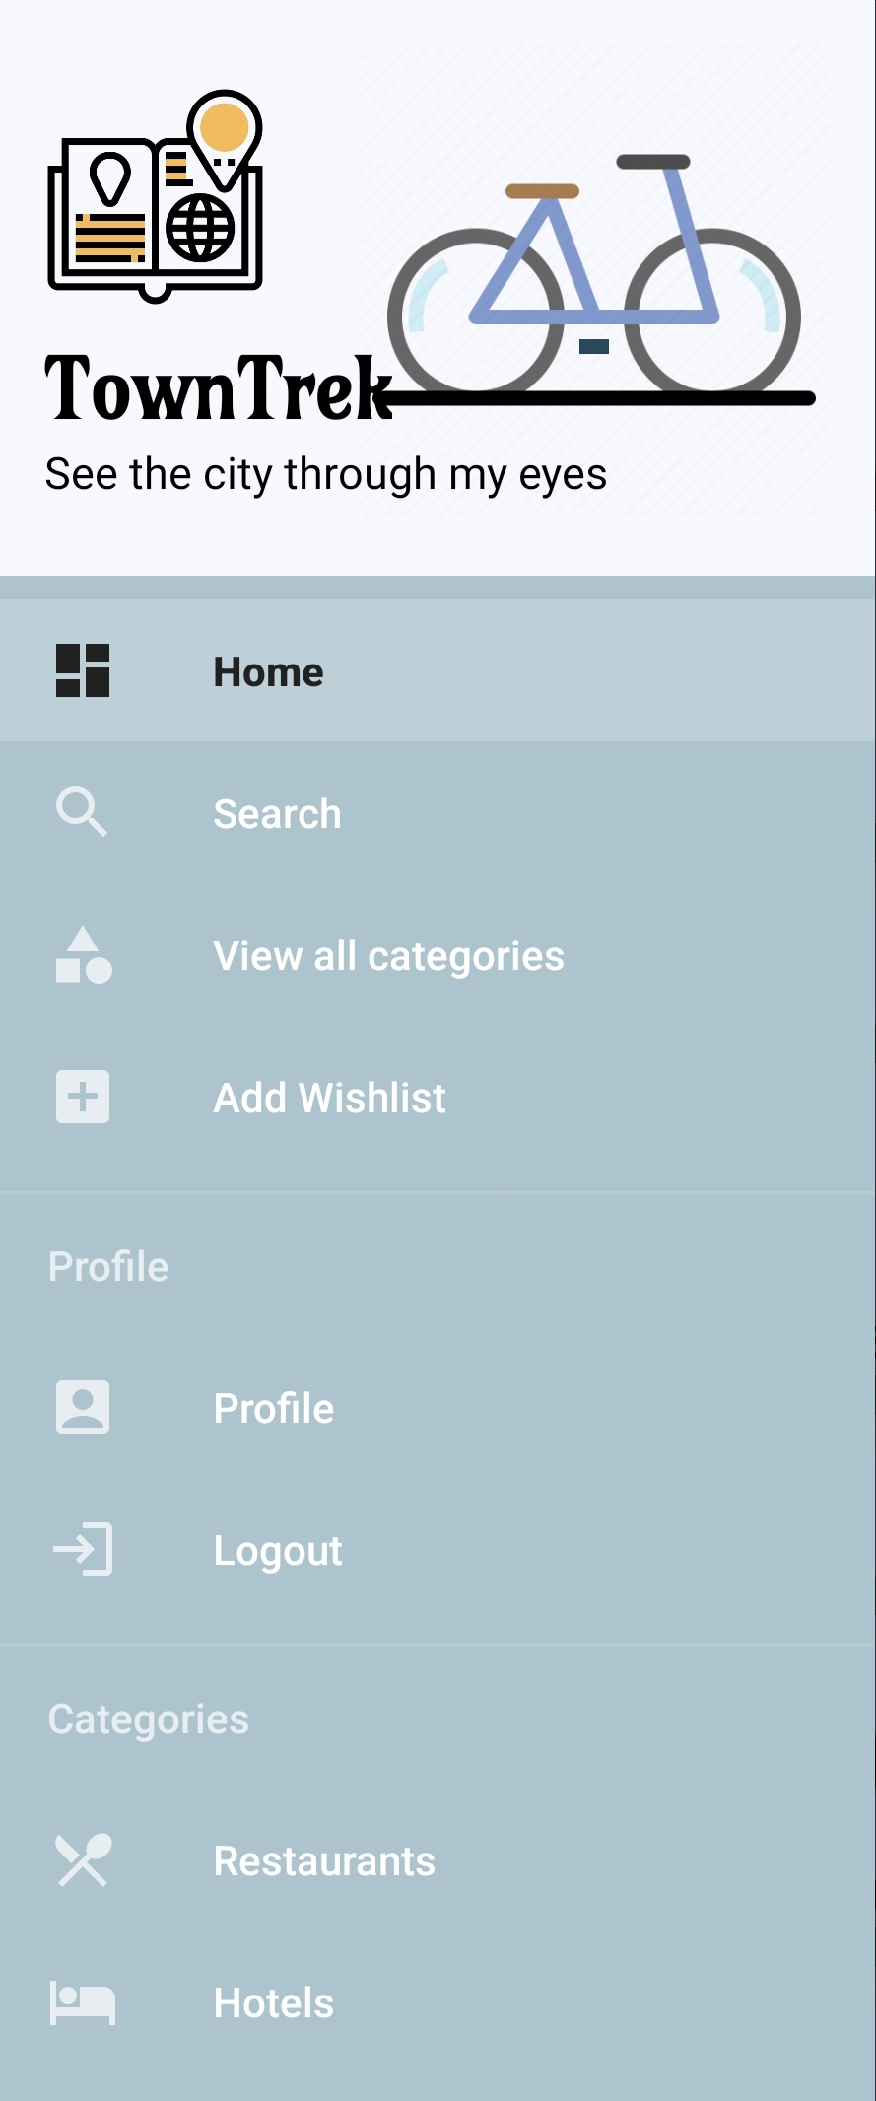
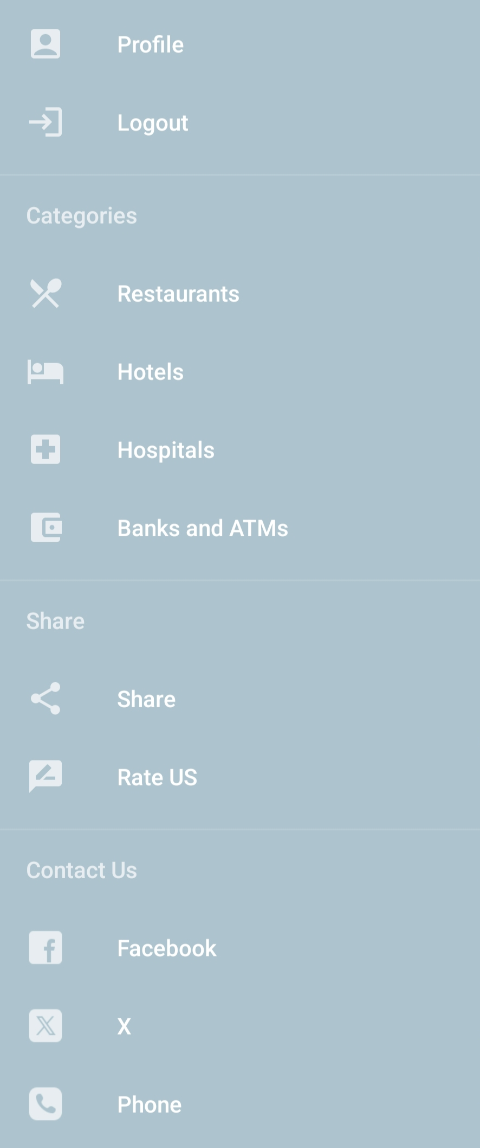
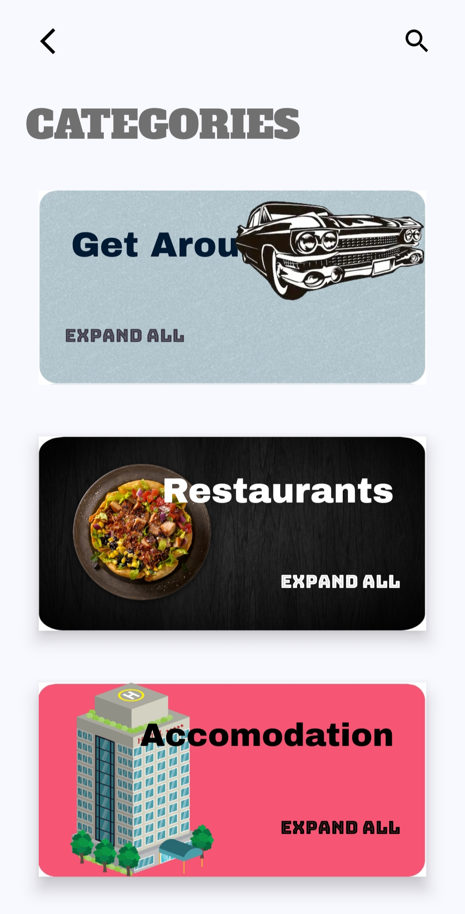
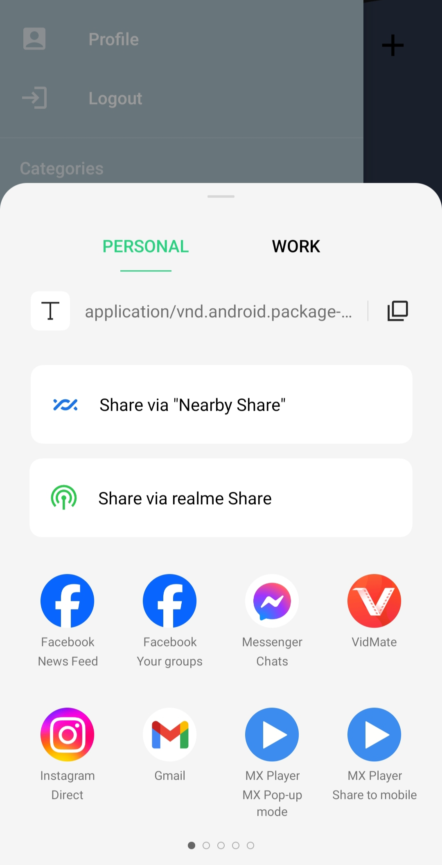
TOWNTREK NAVIGATION DRAWER
Navigation drawer
Categories
Share TownTrek

Slide 13
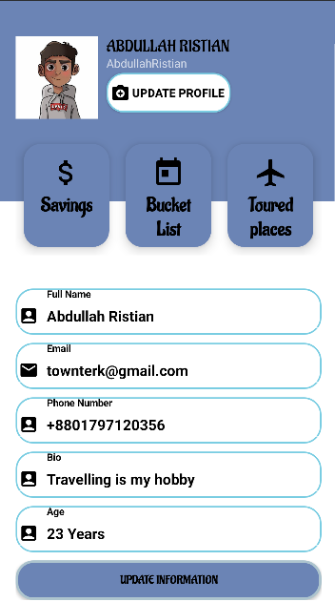
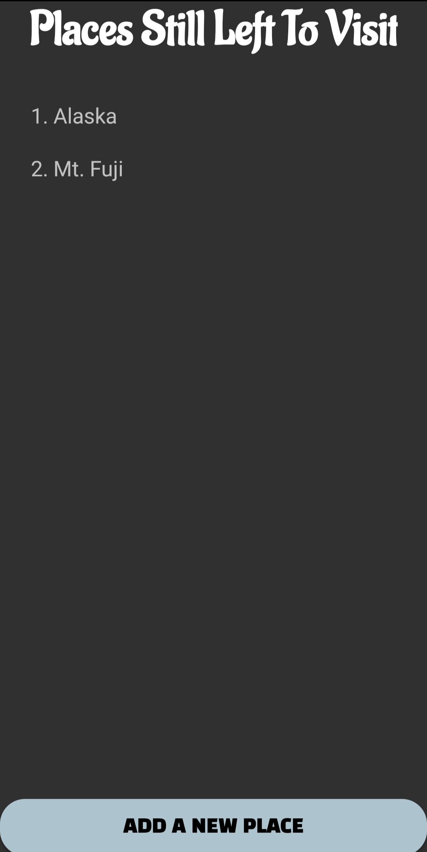
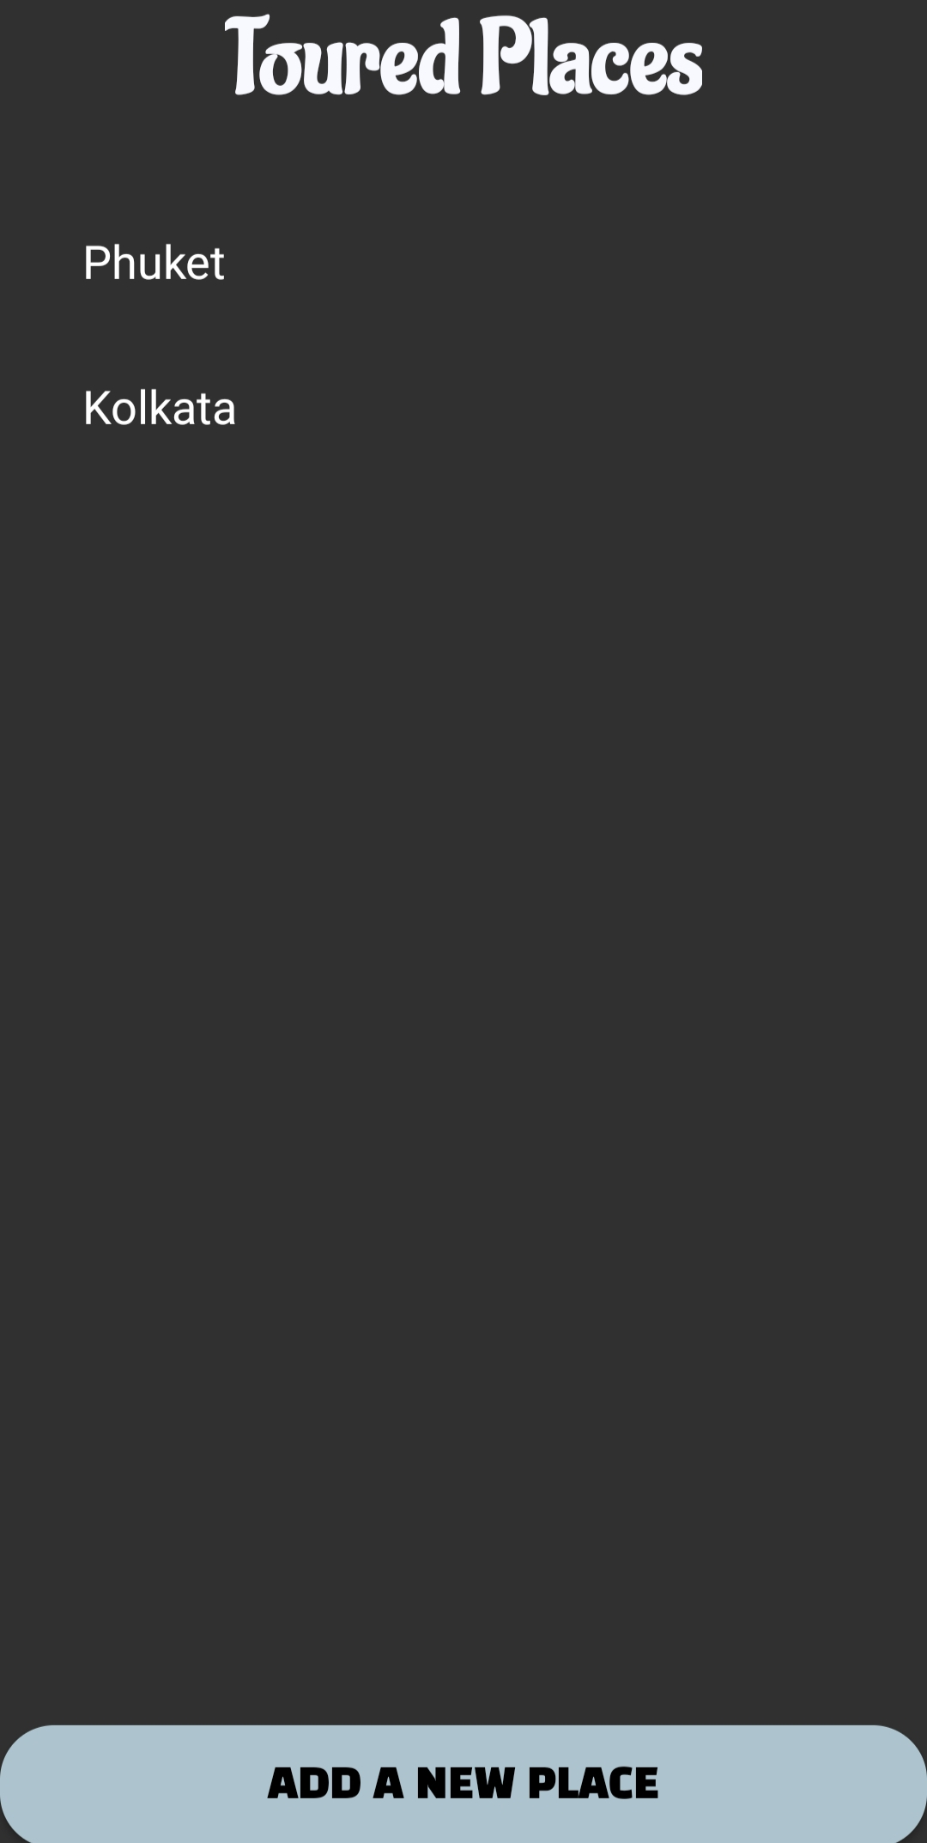
Visiting Historical Spots and Weather Update
Profile information
Toured places
Bucket list

Slide 14
Future improvement in TownTrek
Voice-Activated Assistance
Focusing on personalized preferences based on user’s bucket list.
Multilingual Support for international tourists.
Geolocation-based Narration.
Focusing on the accuracy, performance, and security of the existing features of the application.

Slide 15
Thank you!
"Embark on a journey of discovery with “TownTrek”. Explore, experience, and let “TownTrek” be your guide to unforgettable adventures."

